Slide 1
Outdoor Education
GUSA Budget Summit February 2019

Slide 2
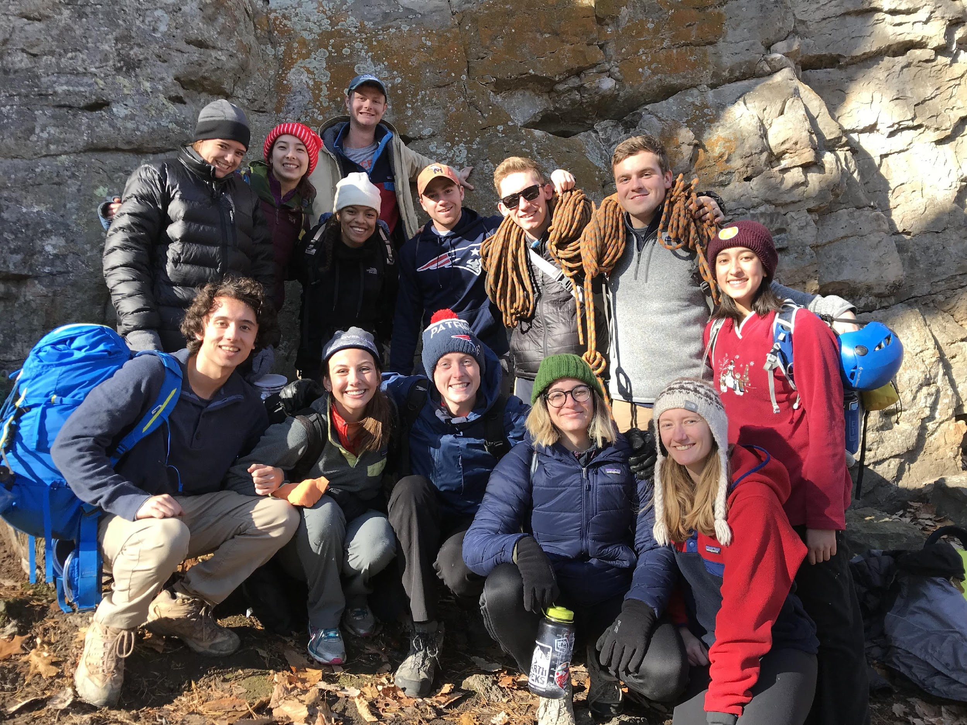
Introduction
Kris Nessler – OE Director
Ellen Bannon ‘19 – Guide and Goat Class Instructor
Marta Jereberts ‘22 – New Guide
Kesiah Clement ‘19 – Guide, Goat Class Instructor, former GOPOP Coordinator
Will Thacher ‘19 – Guide and Goat Class Instructor

Slide 3
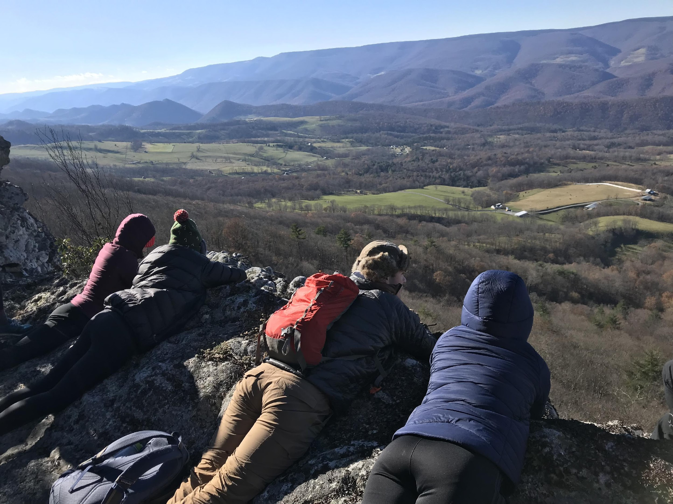
Mission & Organization Structure
Through wilderness based endeavors, Georgetown University Outdoor Education seeks to teach, to inspire, and guide students, creating a community where learning, personal challenge, reflection, and increased compassion for others and the environment are fostered and upheld as core values.
Outdoor Education is a department within the Center for Student Engagement
1 Full-time Director
33 Student Guides (average 50 applications for 12 spots each year)
Programming
Open Enrollment trips
Guide training/development

Slide 4
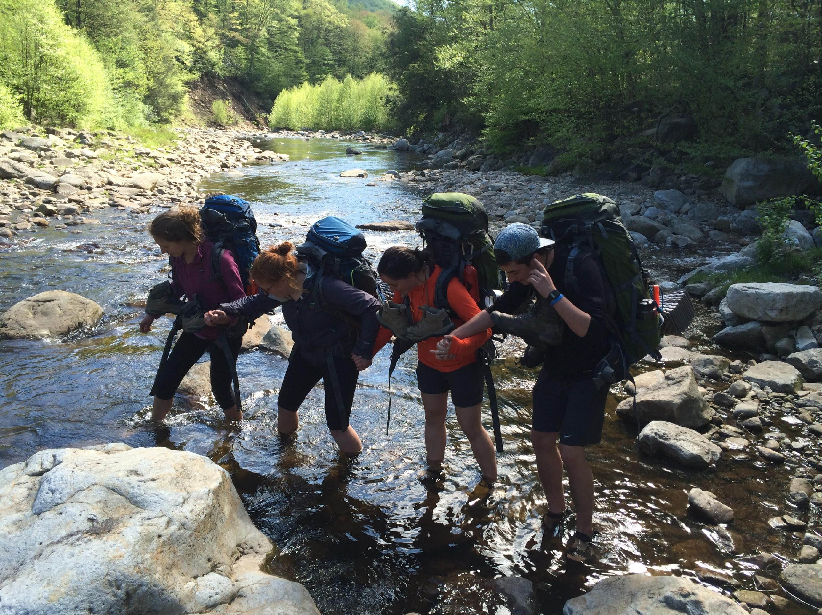
OE Trips
25/30 on the calendar each semester
Hiking, backpacking & climbing are our main programming areas.
Some paddling, caving, and skiing.
Interest has been consistently good, weather not so much.
2017-2018
31 trips with 232 student participants
1,856 field hours
Fall 2018
13 trips with 109 student participants
872 field hours

Slide 5
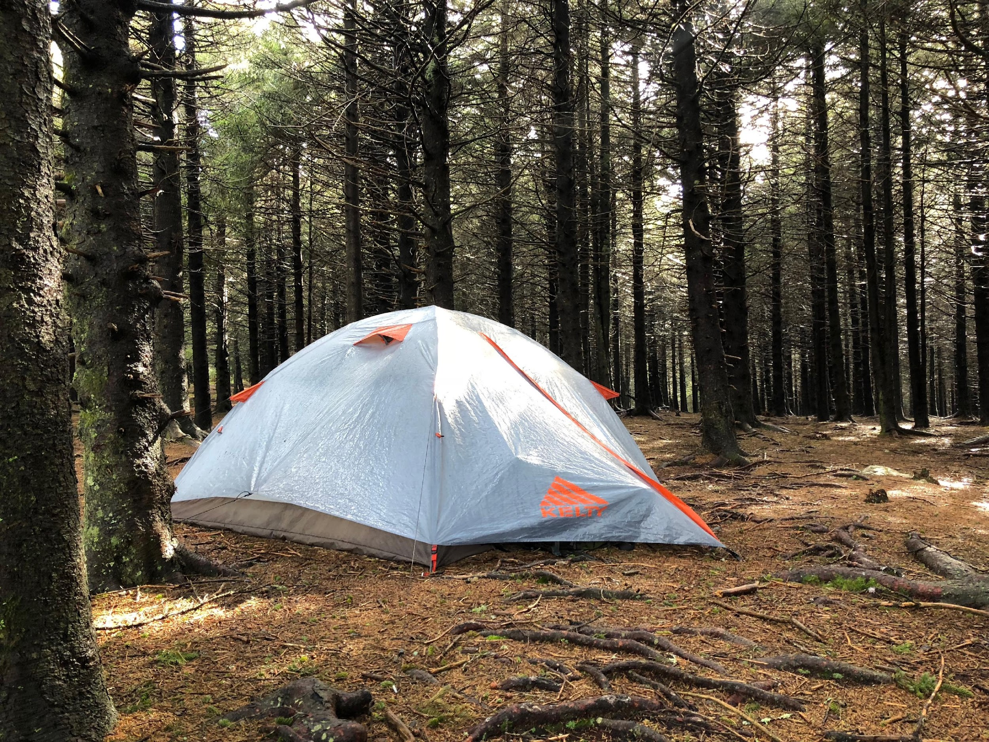
Equipment
OE trips need specific equipment
This year’s request - $3,000

Slide 6
OE Trainings
Trips need to be safe.
Training is a priority – need to give OE guides the skills they need while in the field running trips.
New Staff (GOAT) training course – Outdoor Education
Fall semester
On and Off campus
1,500 training hours
Wilderness First Responder – Wilderness Medical Associates
Required of all OE Guides
70 hour course
Wilderness Protocols
Top Rope Certification – Earth Treks
Must have 2 certified guides per climbing trip
Required by National Park Service
Anchor set-up, belay & rappel management, rescue skills

Slide 7
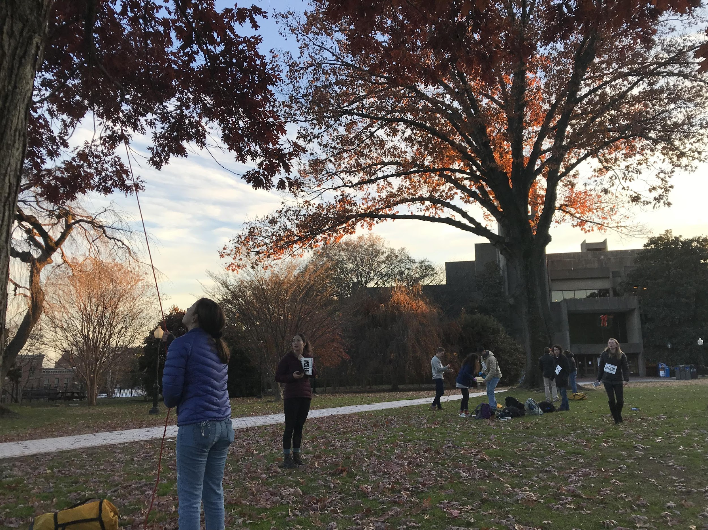
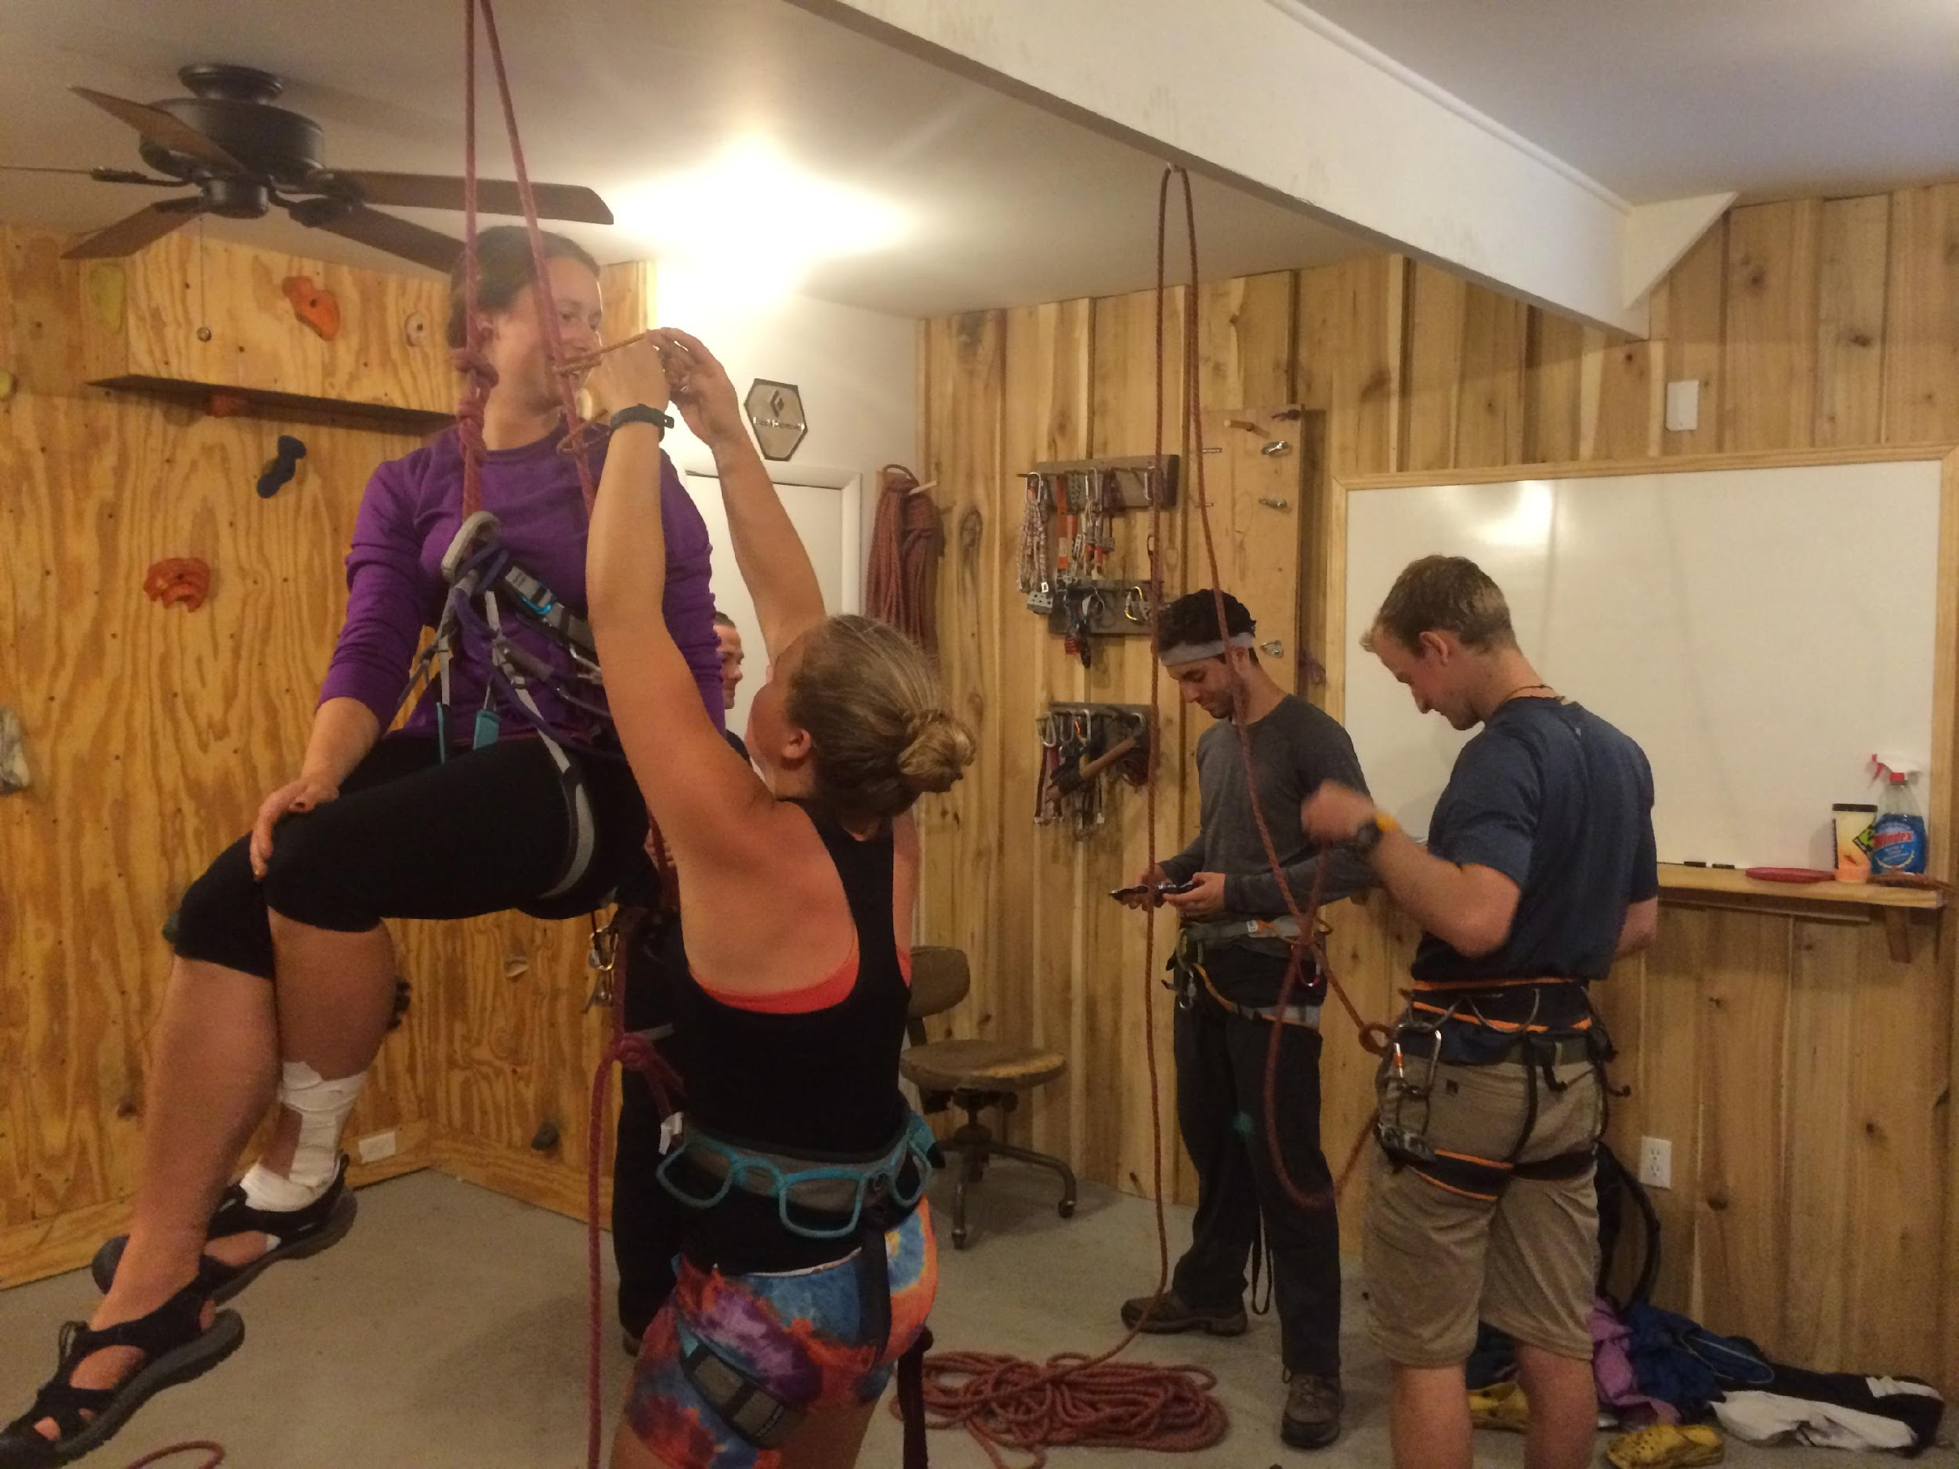
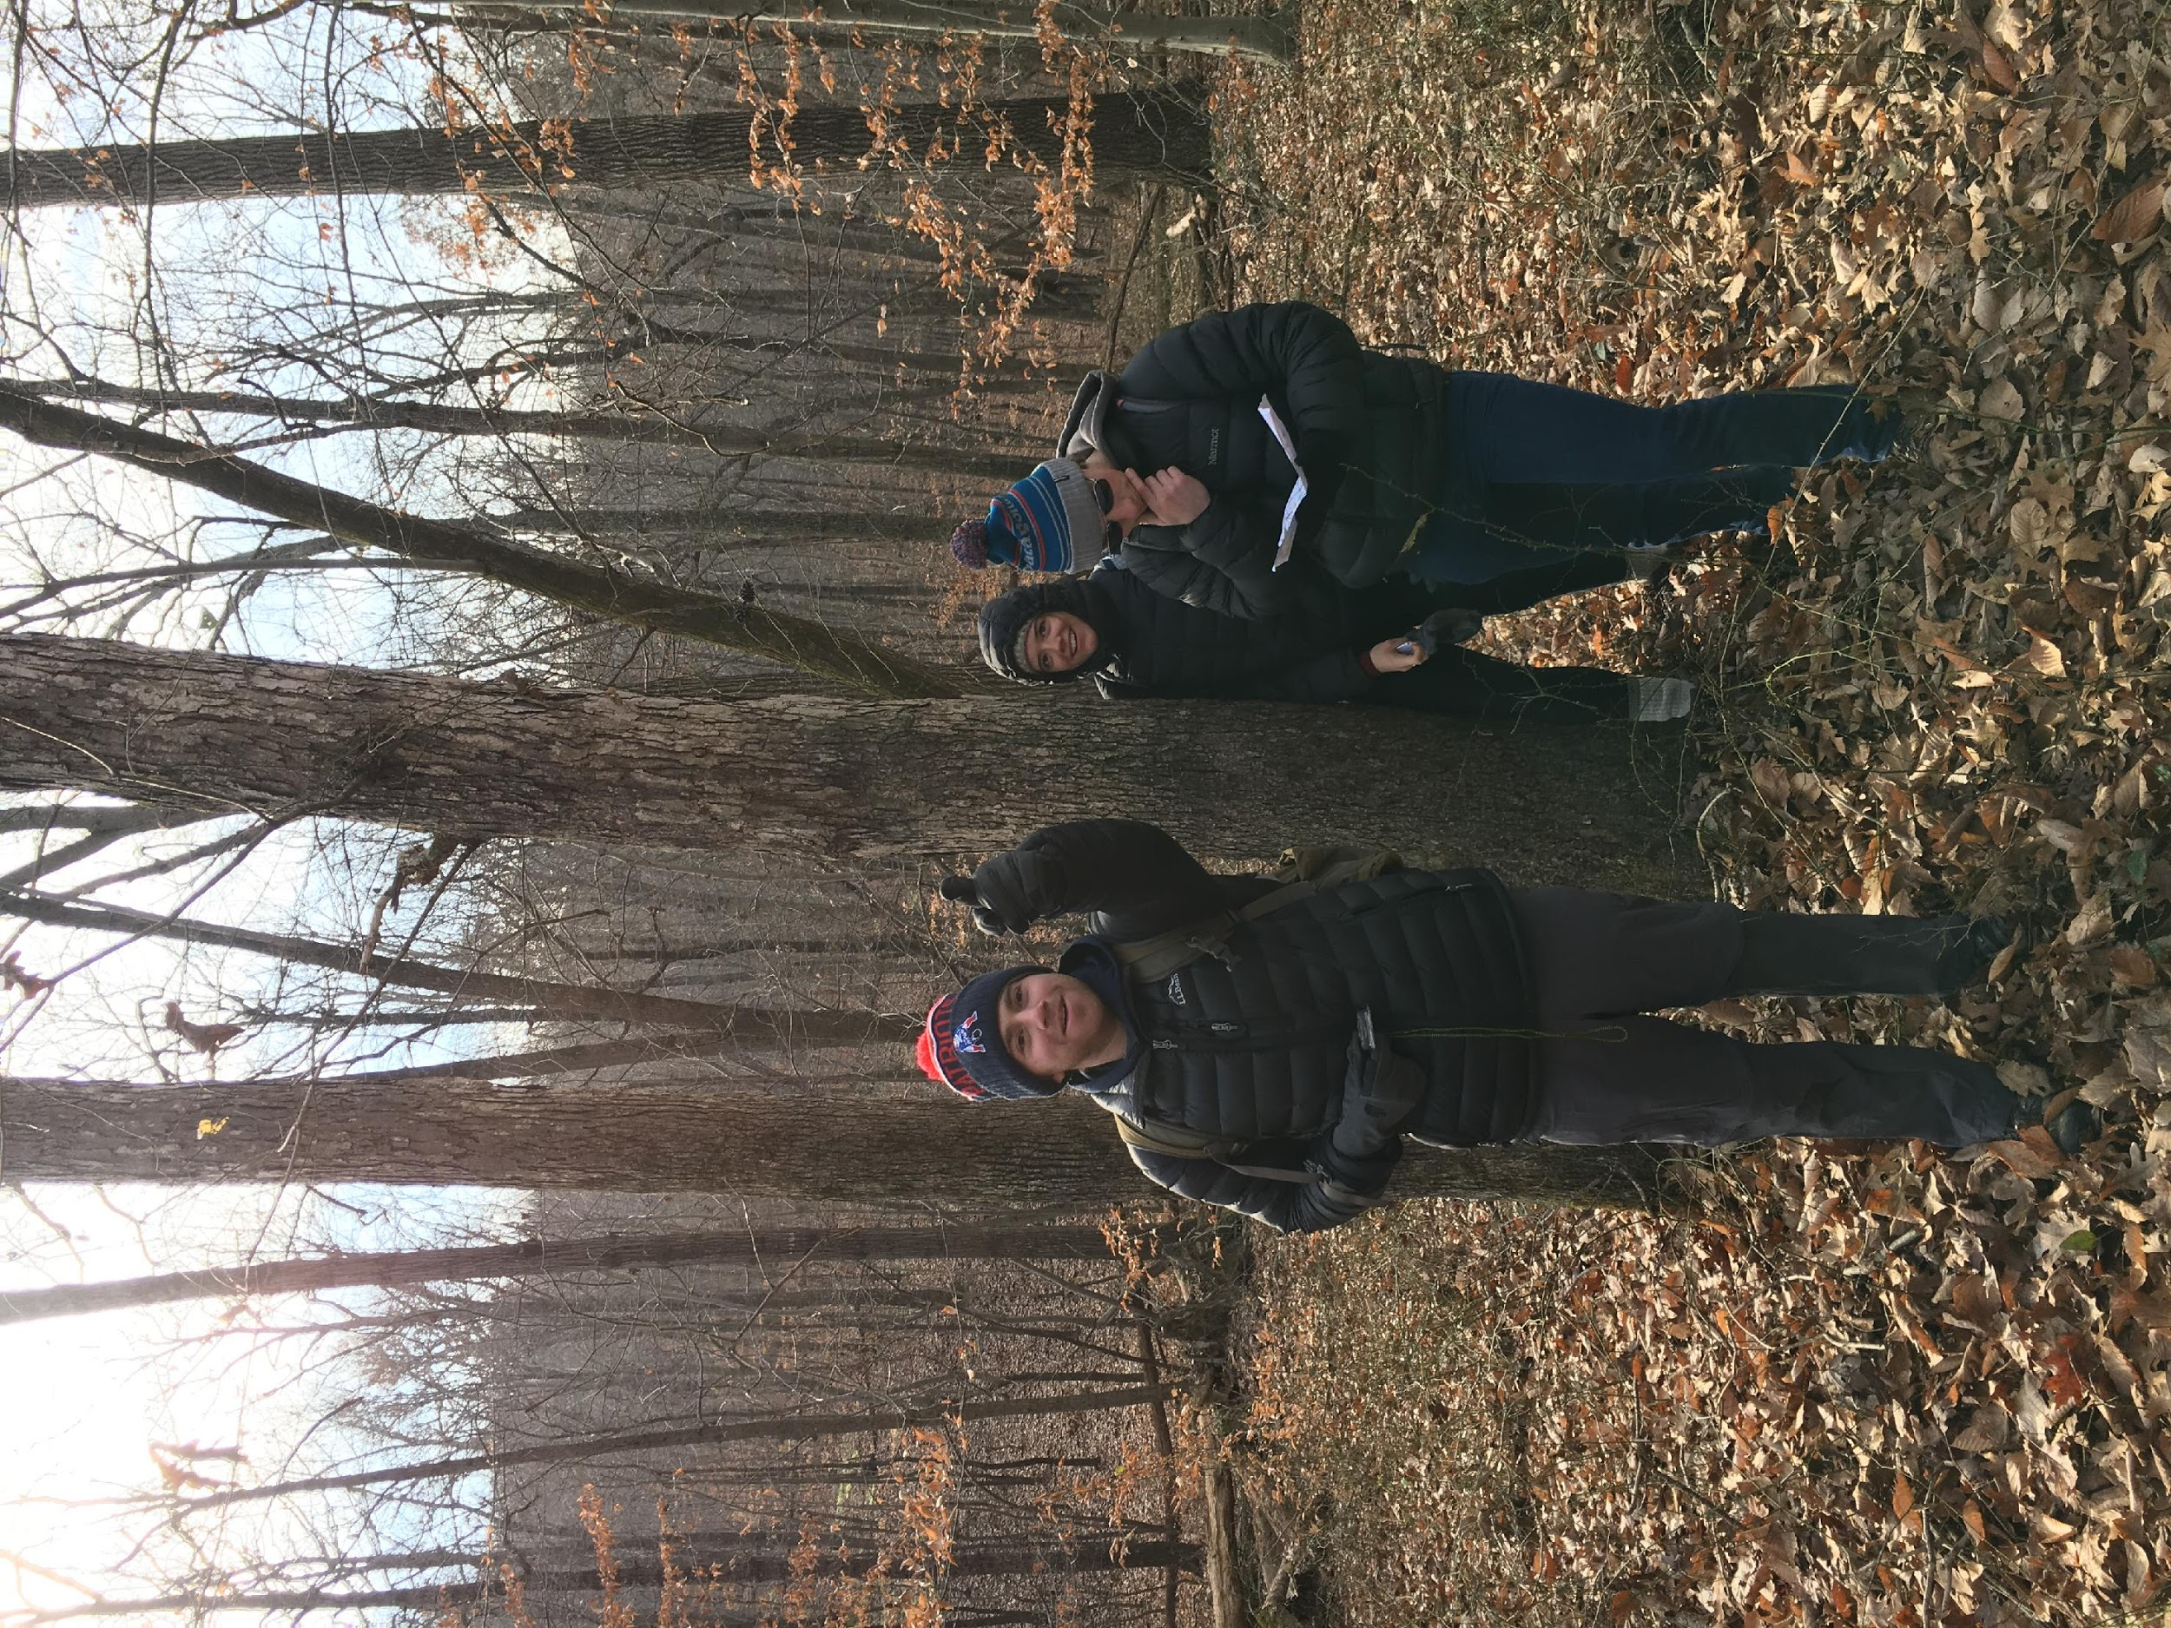
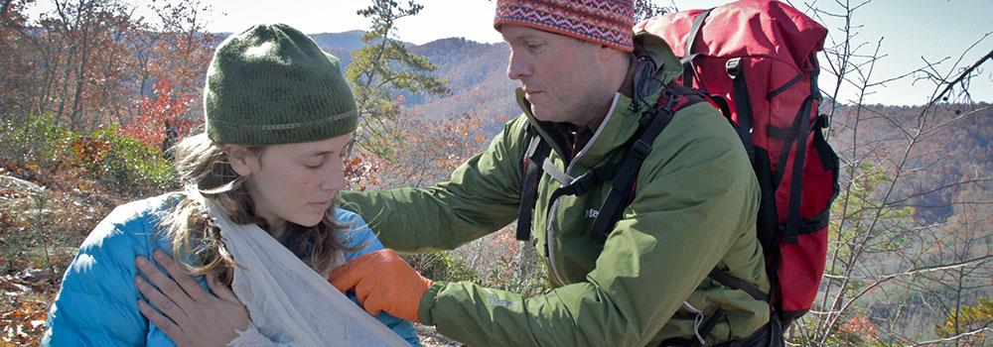
OE Training
OE guides pay approximately 20% of both their WFR and Top Rope Certification.
This year’s request - $9,300

Slide 8
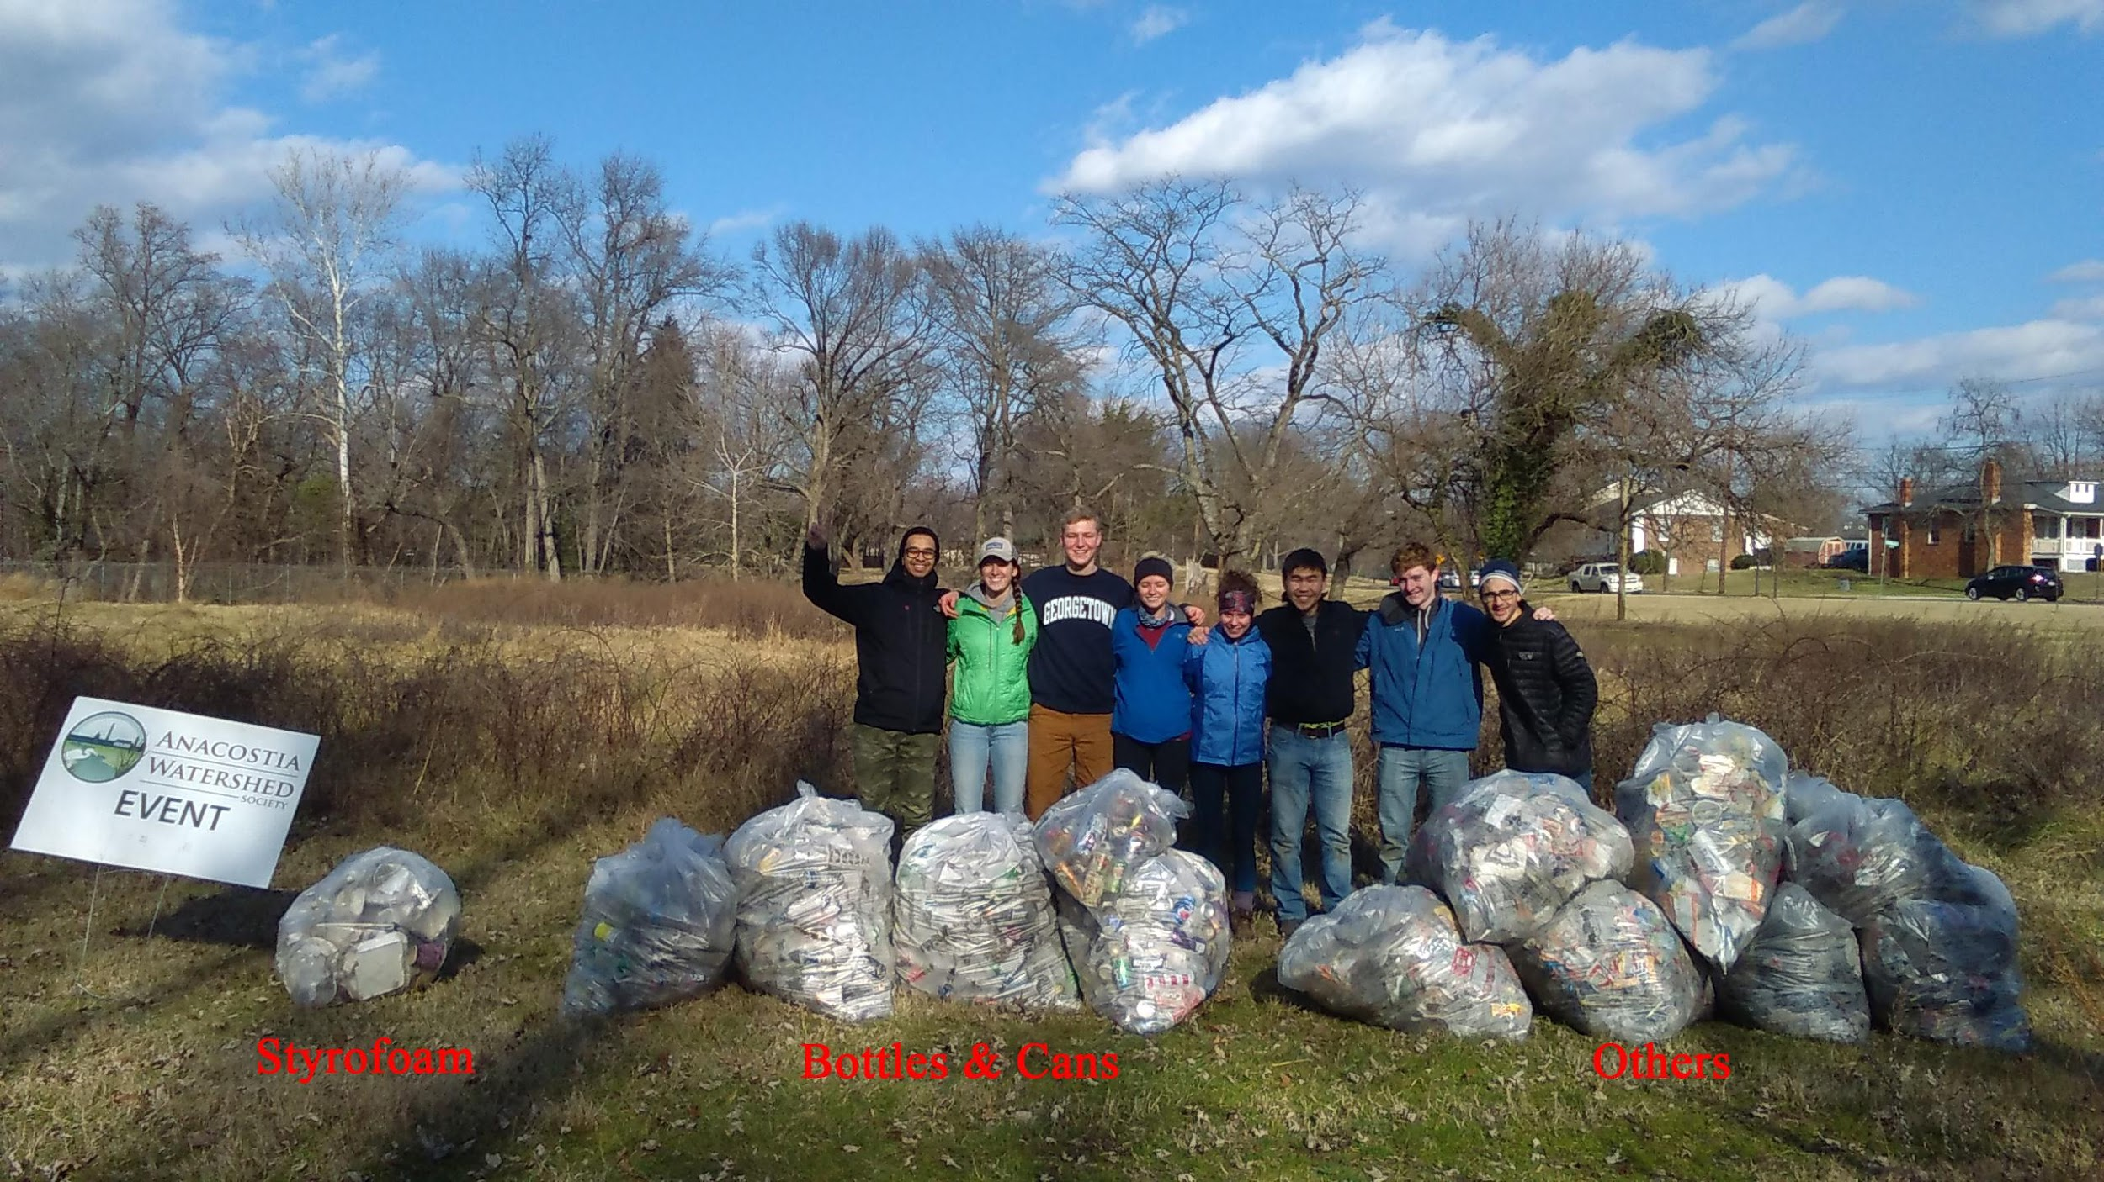
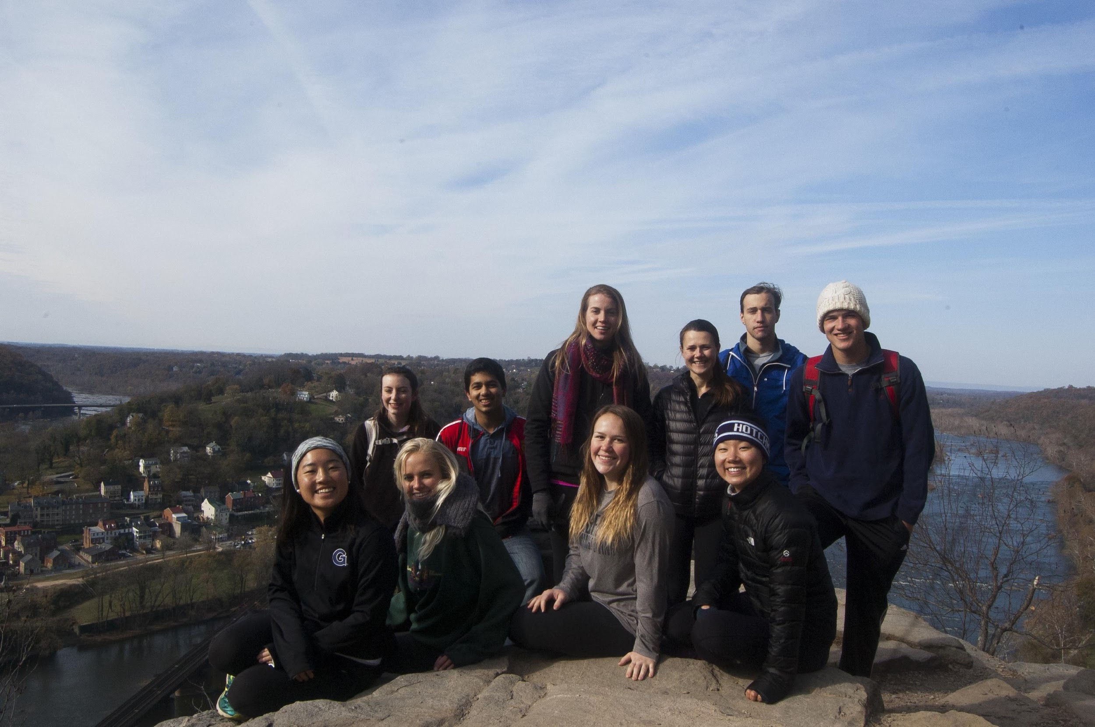
OE Budgeting
OE Trips – offered at cost
Access to students
OE subsidizes trips when needed.
GOPOP has traditionally been source of the OE operating budget.
$6,000 transportation costs
$3,500 in student aid
$1,500 unexpected expenses with Tahoe program
GOPOP 2018 – essentially broke even, no significant dollars to subsidize operating budget.

Slide 9
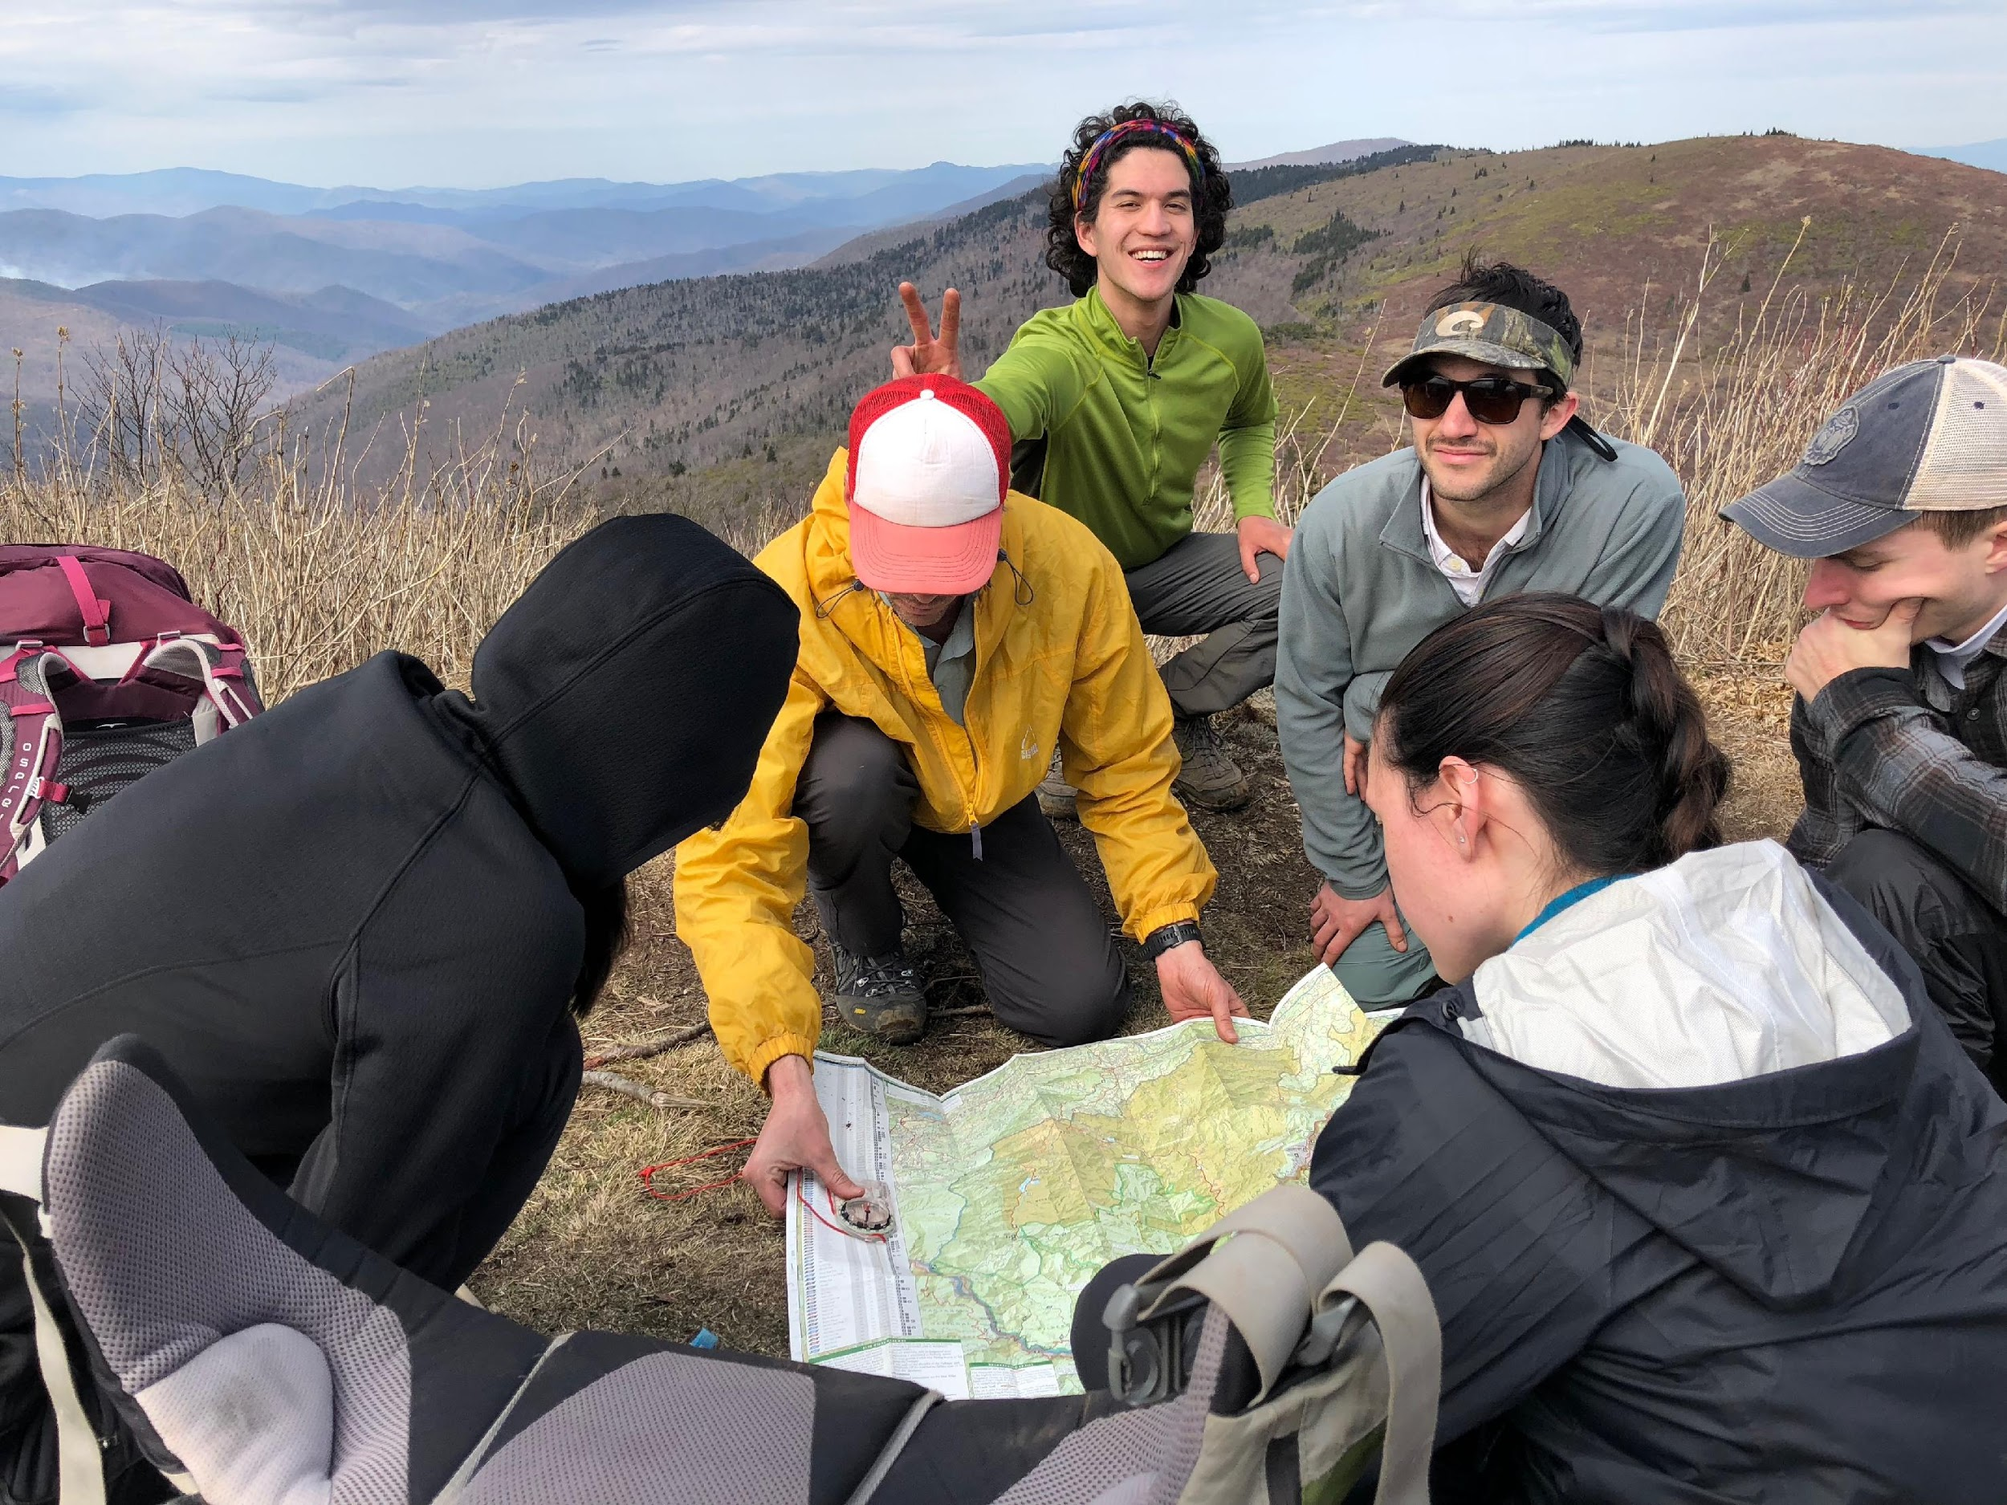
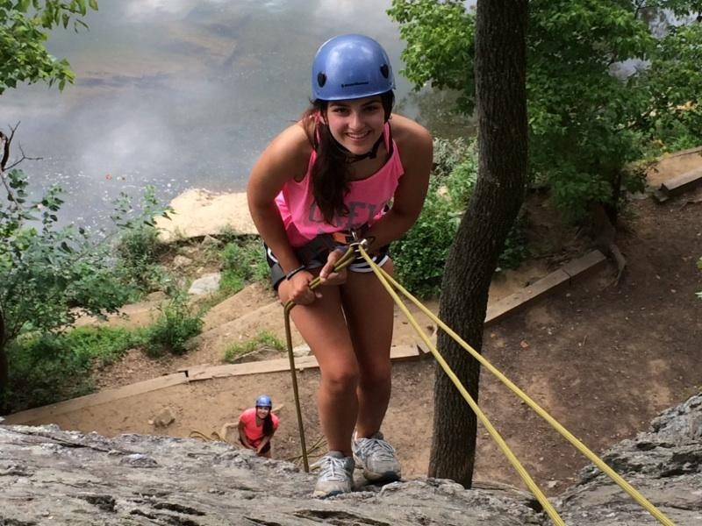
Need for GUSA Support
GUSA Funding allows OE to continue to run high quality programs for the students of Georgetown University.
Trips can be run at low cost = student access.
OE Guides are well trained, run trips within their skill level.
Equipment and Training are expensive.
Without GUSA support:
Equipment and training costs passed onto students participating on trips.
Less student access
Guides
# of trips

Slide 10
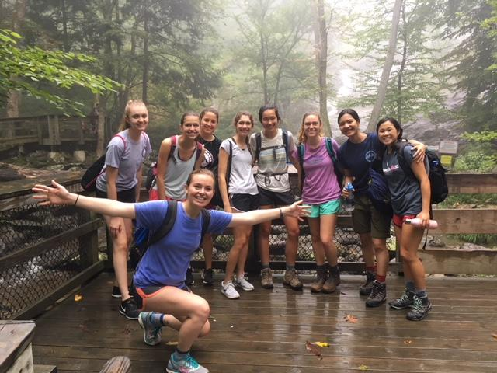
Questions?

